Slide 1
Project Title :
Web-based course registration system
(W-CRS)
Student Name: Asem Mohammed Abdulziz
Farhan.
Matric No. : 108522.
Supervisor Name : MR-Ismail Al-Hadi.

Slide 2

It's a web-based system used to allow the registrar and the students to register available courses according to their program in every semester correctly and efficiently that for both branches (Boys, Girls).
Course Registration System is a web-based program aimed to make easier and more convenient the registration process that covers all the aspects of the registration process to be satisfying, effective, & efficient as possible by analyzing the current system, and to generate main reports.

Slide 3


Recently, most major universities have moved from manual registration systems to web-based systems that allow students to search and register for courses. As more universities follow this trend and begin to offer online registration, it will become increasingly important for these systems to be considered usable by all students. In addition to make the system being usable, it must also provide the student with convenient access to information that will ease the registration process.

Slide 4

  The current system doesn’t show the courses offered that the student can take in each semester.
  The current system doesn't point out student to the remaining subjects that he/she should take for next semesters.
  The current system doesn’t stop a student from adding and dropping courses after out period (doesn't impose the due date).
  The current system doesn’t check the prerequisites courses of each selected course, whether the student passed in all the prerequisite of that course.

Slide 5

  The current system doesn’t provide the required reports.
  The current system doesn’t check the credit hours of the courses taken by the student.
  The current system doesn't show the status of the course taking.
  The current system is using different databases for the girls' and the boys' branch.
  The database of the current system is not connected, that mean have separate database for each semester. That leading to difficulties in searching, updating, reporting, integrating, and consistency of data.

Slide 6

Manage the courses information.
To automate the registration process.
Identify the offered courses in each semester.
Allow the student to register courses only if has passed in all the prerequisite courses of those courses.
Allow the student to add and drop the courses within specific period.
Show the taken, registered ,remind courses of each student.
To simplify the reporting process.
To enhance the system with help facilities.
Use one database for both girls and boy' branch.
To provide a user friendly system interface.
To facilitate the searching process.
To sufficiently train the users of the new system.
Passwords and security management.

Slide 7

This project is focusing how to accomplish the main goal which is developing course registration and meet all system requirements. The users of W-CRS:
  The Registrar.
  The Administrator.
  The student.
All one of them has his rules and data access.

Slide 8

The Registrar can:
Manage, search & store the courses information for each program.
Register courses for students if the student has passed in all the prerequisite courses of those courses.
Specify the offered courses in every semester.
Add or drop courses for students according to the courses credit hours within a specific period
Withdraw courses within a specific period.
Set and delete course prerequisite.
Add or drop courses for students according to the courses credit hours within a specific period
View the courses taken by each student.
Generate courses registration slip.
Generate reports i.e. print them or export them to excel.
Manage & store the grades of students.
Search for student.
Add new news.

Slide 9

The Administrator can:
Register courses for students with special cases.
Create a new user or delete an existing one.
Search for student.
Manage, store & delete user.
Add new news.
The student can:
Register courses.
Add and drop courses within the specific period.
View taken, registered ,remind courses .
Change password.

Slide 10

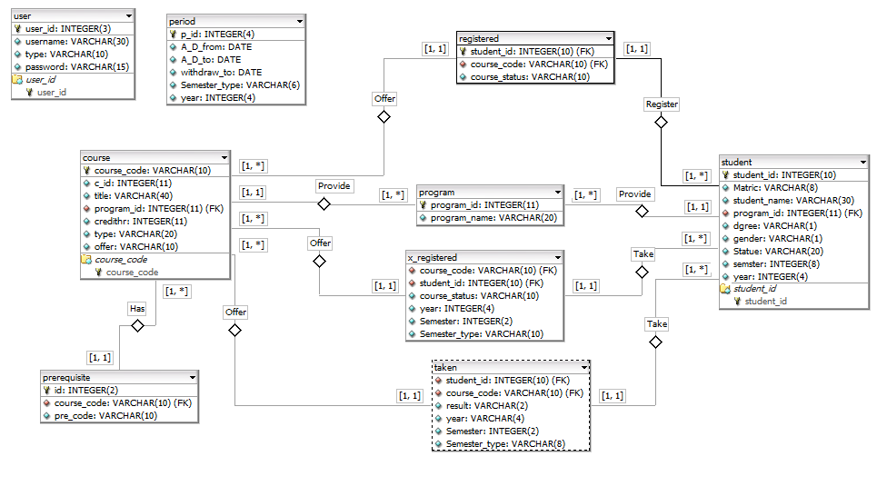

Slide 11

The methodology that will be use to develop this system is the Rapid Application Development (RAD) methodology.

Slide 12

Planning Phase (Project Plan):
  Defining the system to be developed.
  The project scope – a high level of system requirements must be defined and put into a project document .
Analyzing Phase (System Proposal):
  In this phase, I will gather the requirements from the users by using the following gathering techniques:
    Interviews.
    Brainstorm.
    Requirements.

Slide 13

Designing Phase:
  Creating use cases diagrams, the use case specification and the sequence diagram of the system.
  Designing the systems model: graphically creating a GUI screen design, and databases.
Implementing Phase:
  create prototypes.
  Object Creation and User Review.
    These steps can be repeated multiple times until the system be correct and accepted.
  Finalize code.

Slide 14

Installation and testing Phase:
  insure that the system meets the requirements of the users and university's needs.
  Users training: training the users to use the main interface of system and trying to make the users to interact with the system.
Maintenance and support phase:
  When the installing and testing is completed, I do not stop at this point but I will communicate regularly with the users and know the progress of work and the difficulties that faced by the use.

Slide 15

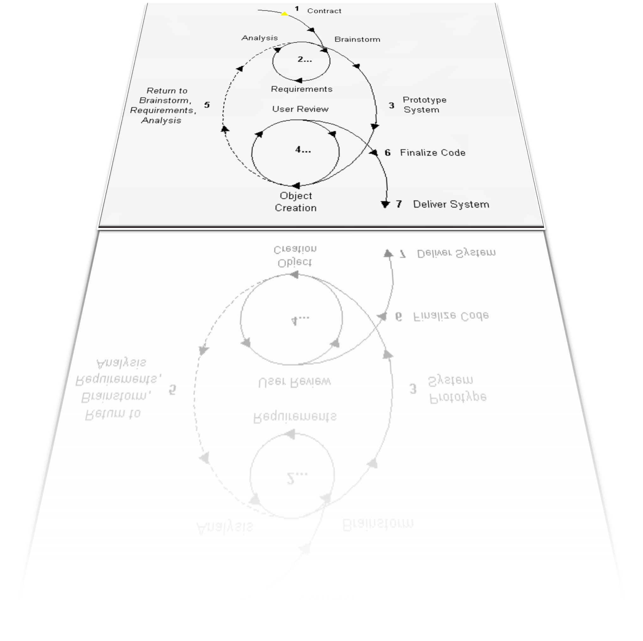

Slide 16

This system is not connected to other departments such as financial or accounting department.
The limitation of internet access since the system is going to be web-based.

Slide 17

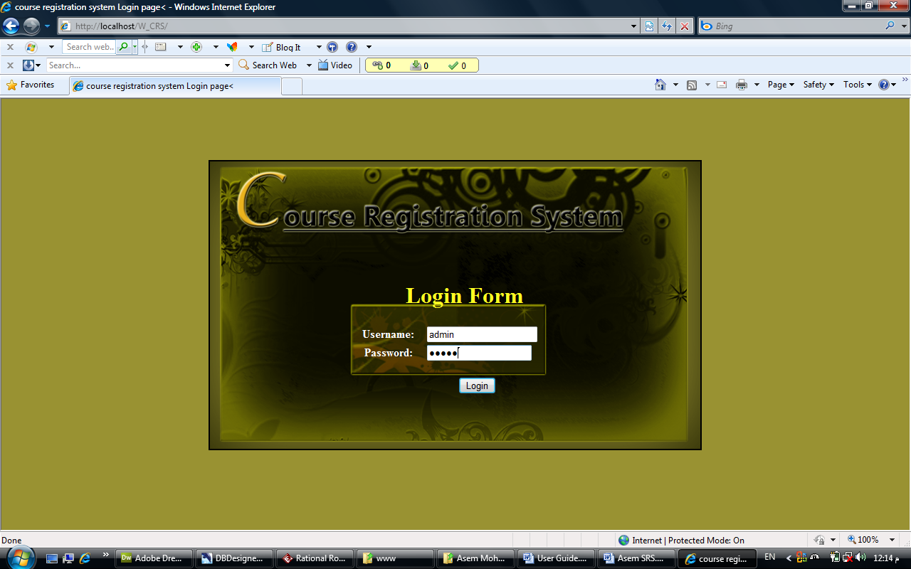

Slide 18

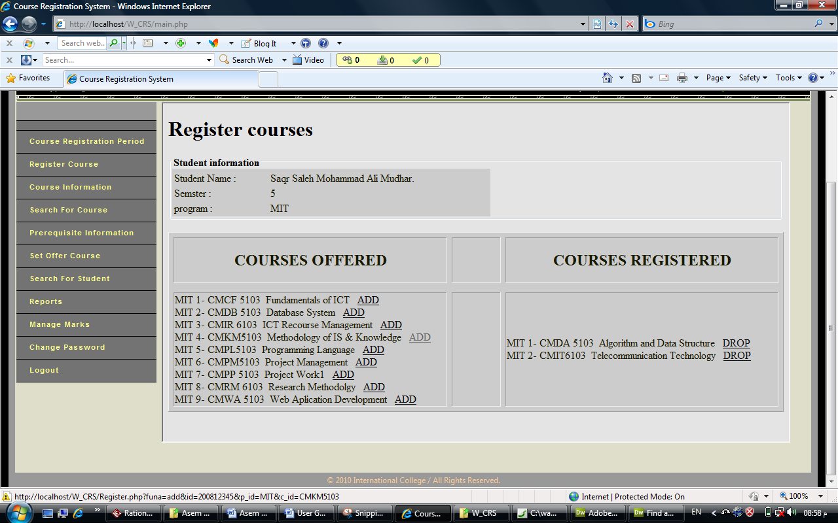

Slide 19

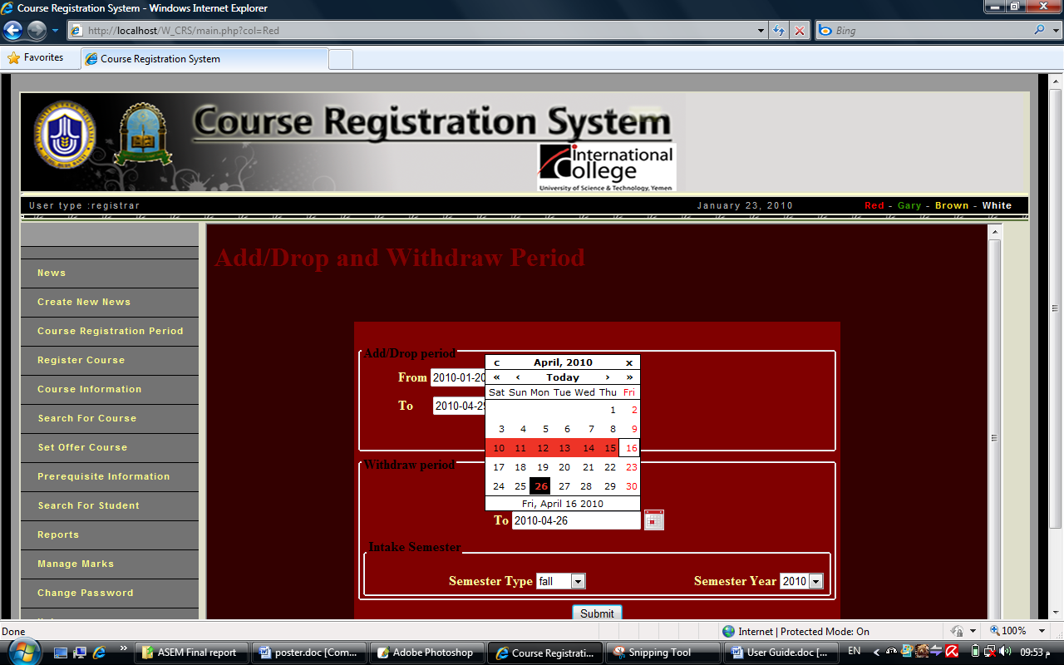

Slide 20


